Slide 1

Escaping the Data Doldrums
Sean Flynn, Dev / Analytics
William & Mary Advancement
#tea1
Notes:
Transforming basic analytics into holistic data-driven decision-making

Slide 2

About Me!
Dev/analytics/digital strategy for William & Mary UMAC (for another week)
Previously: HigherEdJobs.com, Penn State, Northwest Florida State College
Primary work in PHP, JS (ask me about Knockout JS!), smattering of R, etc.
#tea1

Slide 3
What about you?
How many of you are primarily…
Coders?
Graphic designers?
Marketing?
Editorial?
Technical management?
#tea1
Notes:
Everyone wears multiple hats, it’s higher ed. But!
This is optional and nobody signed up for 8:30 a.m. interactions BUT…
If you’re not in one of these categories, and you’re comfortable sharing, raise your hand!

Slide 4

This is a “Tech-lite” presentation
This presentation is for you! But it’s especially for you if you’re looking for ways to build a culture of data-driven decision-making
Some of these concepts require some data manipulation to execute, but we won’t be diving deep into them
Instead, we’ll focus on concept & strategy
#tea1

Slide 5

Don’t worry about taking notes!
#tea1
The entire Powerpoint will be on Github
Email: sean.flynn@gmail.com
Twitter: @wxgeek
github.com/sflynn850/heweb19

Slide 6

What we’ll cover today
Building a foundationally sound analytics stack
Building a data-infused decision-making culture
#tea1
Notes:
DATA INFUSED vs driven: Data should infuse every step of your strategy - planning, execution, evaluation

Slide 7
On Sharing Data
I’m going to share a lot of screenshots and data today
None of it is redacted, and I’m happy to answer questions about any of it
Professional recommendation: Lots of us aren’t in competition, especially in Advancement.
The more you can share with each other, the better we all become.
#tea1

Slide 8

Part 1 – Establishing Foundational Analytics
#tea1
Notes:
Sources, tools, reporting

Slide 9
Meet our data sources!
Google Analytics / Tag Manager
Salesforce Marketing Cloud
Social media sources
#tea1

Slide 10
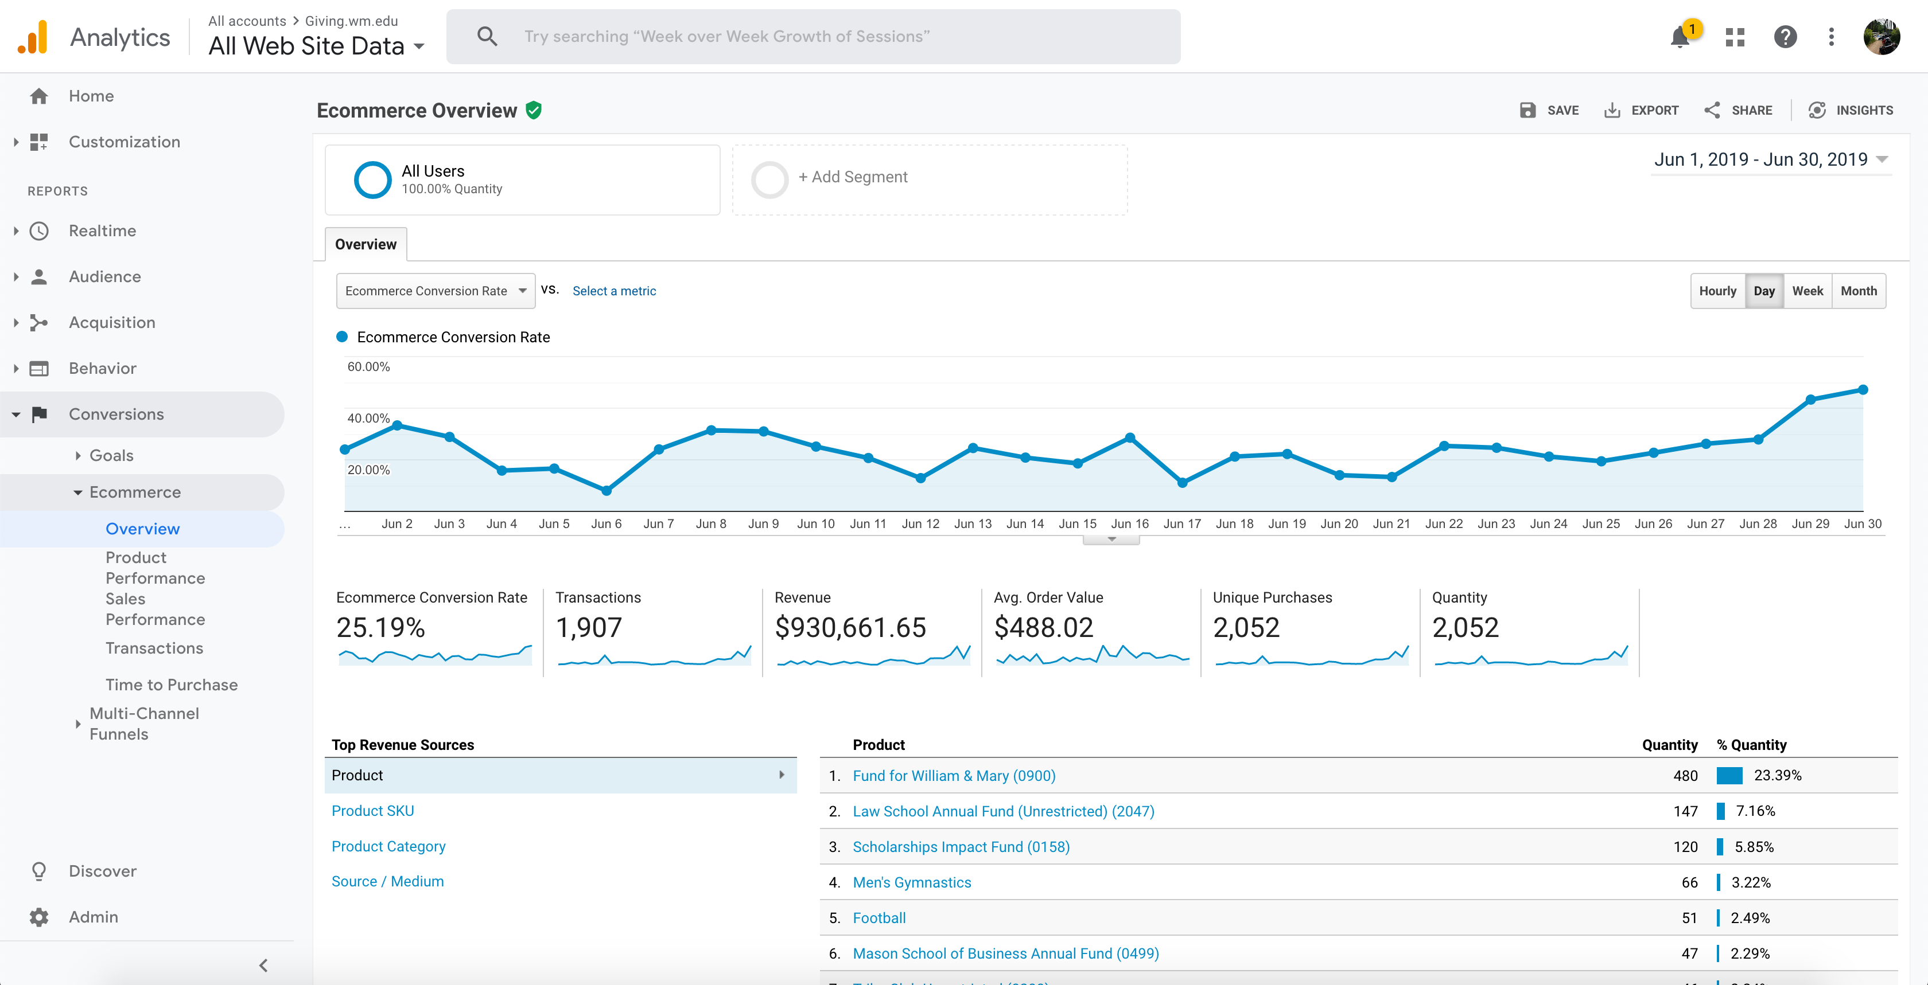
Google Analytics
Basic web analytics tracking (pageviews, sessions, traffic sources, etc.)
Event tracking via GTM
Ecommerce tracking (for giving site)
#tea1
Notes:
Data from fiscal year end fundraising in June
Autofeeds into google data studio – no effort required

Slide 11
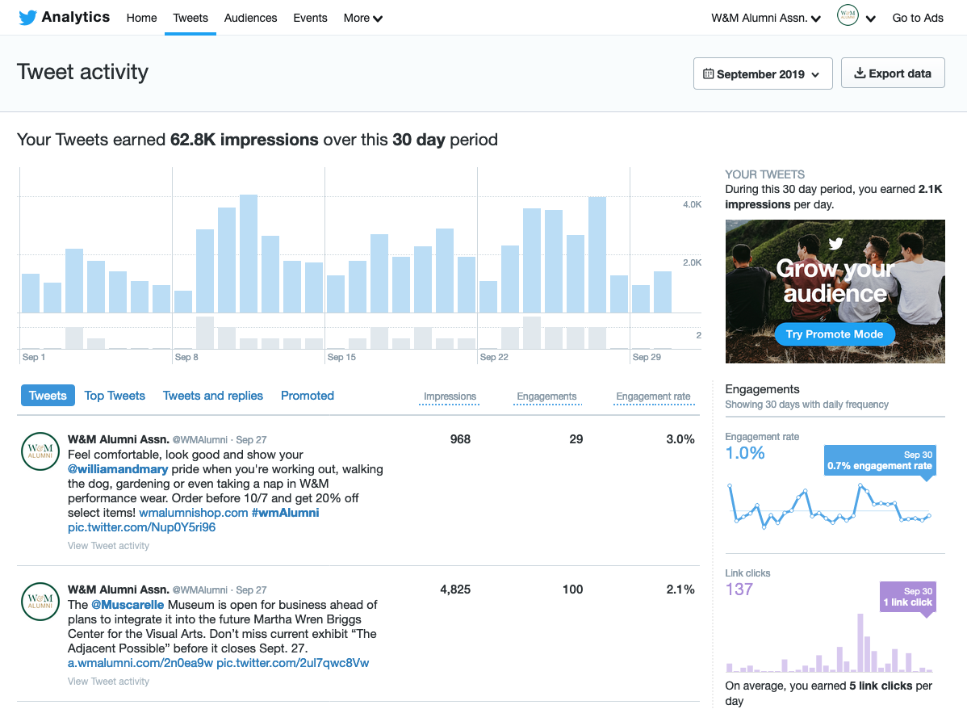
Twitter
#tea1
Notes:
Manual export required to GDS – third party connectors likely available but they tend to cost money
.CSV can be ingested without modification

Slide 12
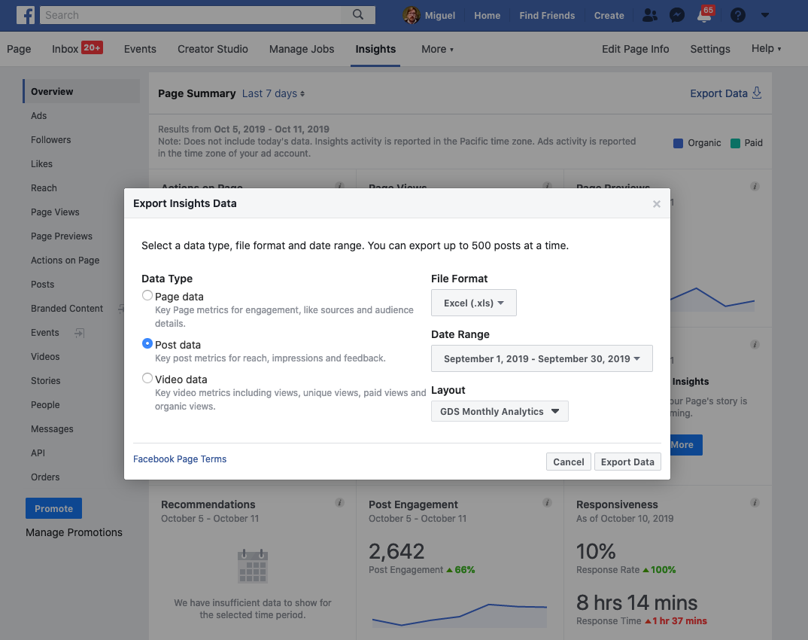
Facebook
#tea1
Notes:
Facebook excel file can be relatively quickly moved into a .csv, but requires some manipulation
Consider making a macro!

Slide 13
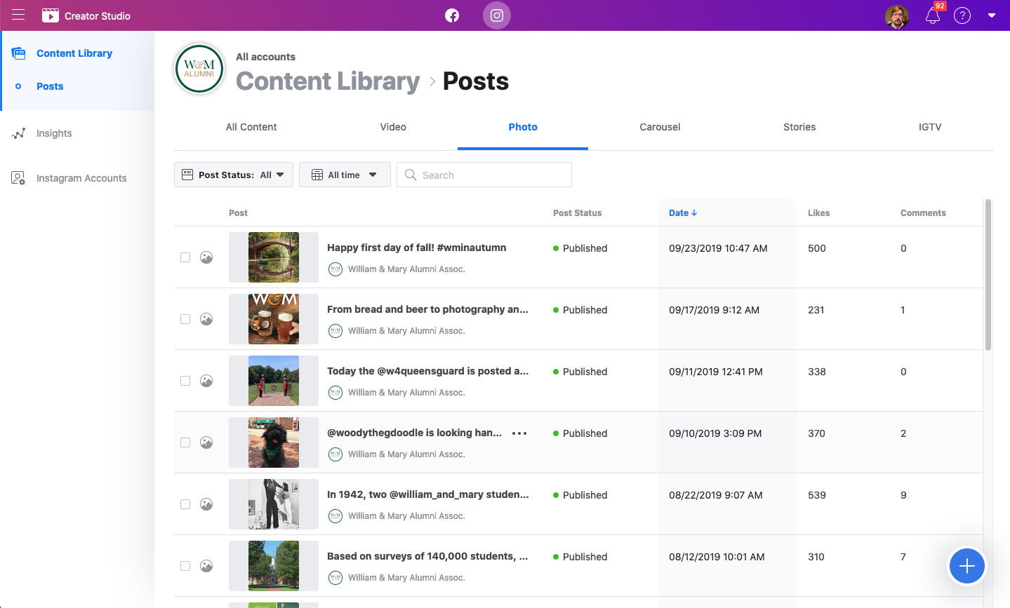
Instagram / IG Stories
#tea1
Notes:
Instagram analytics are awful. Entirely manual data entry

Slide 14
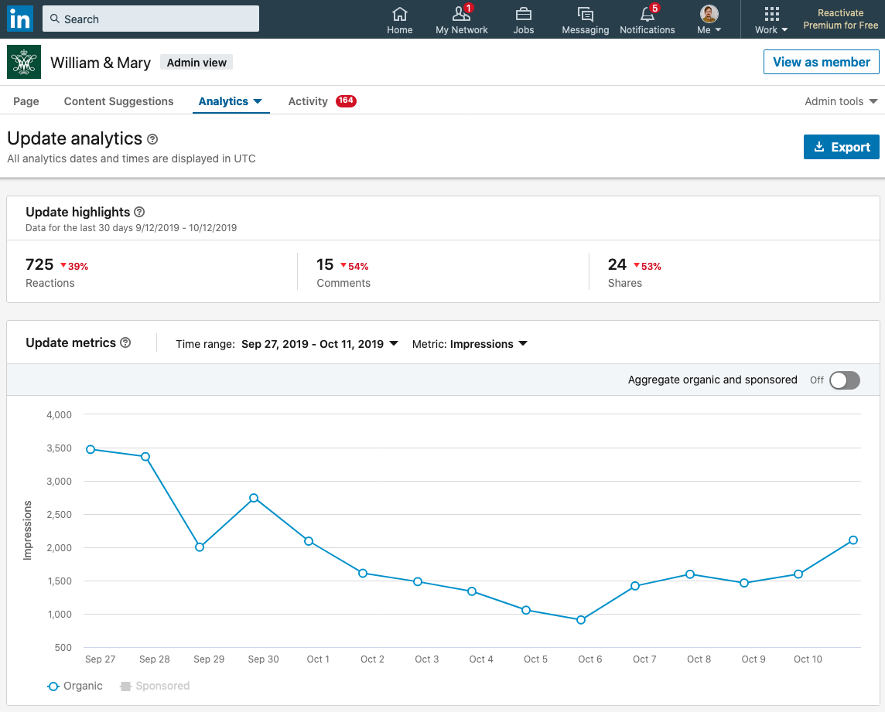
LinkedIn
#tea1
Notes:
Linkedin .csv is ingestible immediately

Slide 15
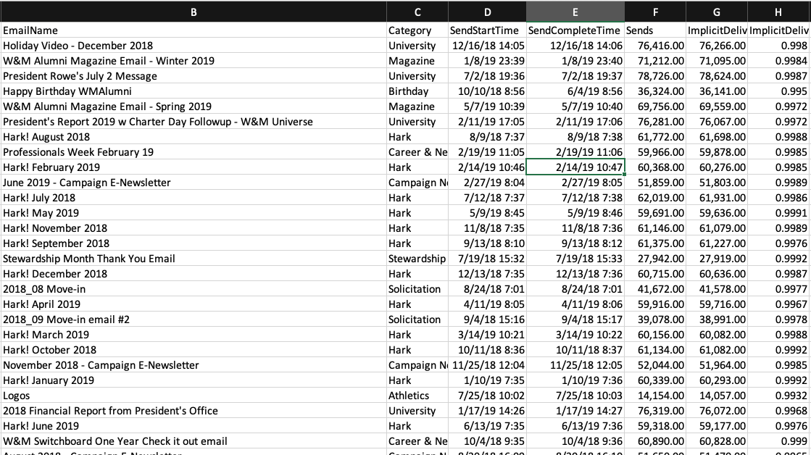
Salesforce Marketing Cloud
#tea1
Notes:
Salesforce Marketing Cloud
CSV import
Some data cleaning / data entry required
Manual categorization ☹

Slide 16
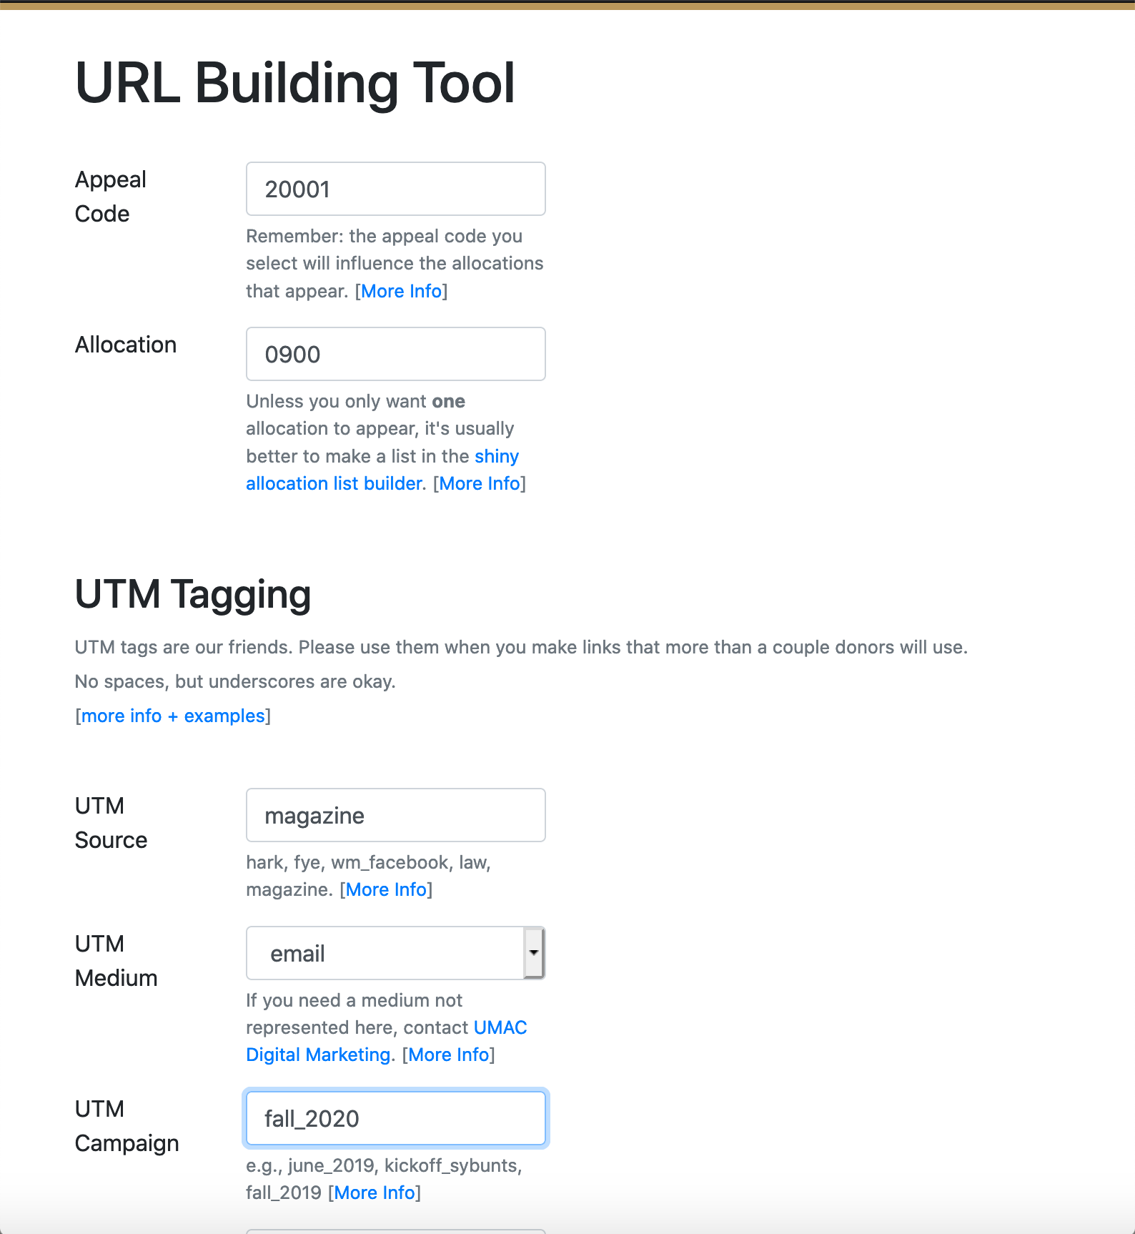
URL Builder
#tea1

Slide 17
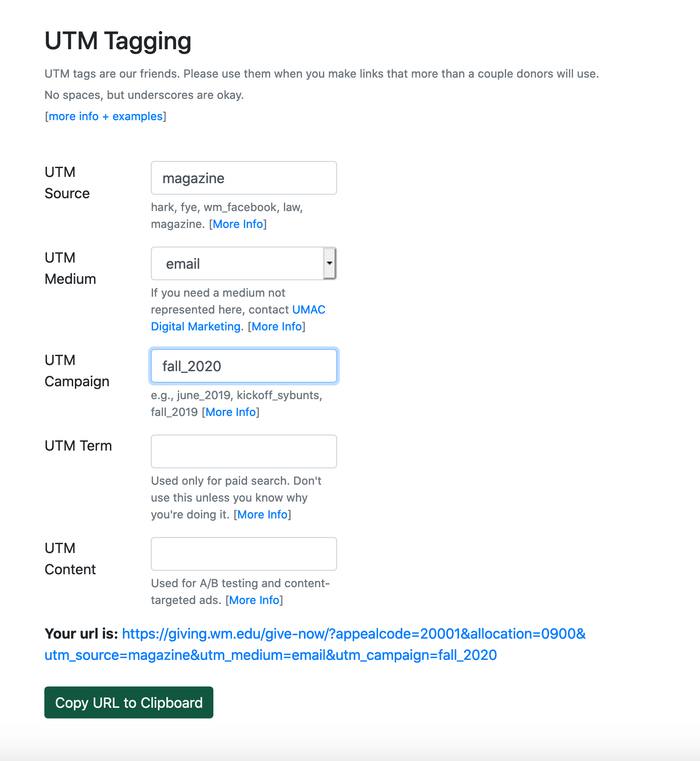
URL Builder
#tea1
Notes:
Traffic source reporting
UTM Tags – Jackie’s presentation, “From “UMM…Codes?” To UTM Codes” LIT13, Tuesday, 1:30
Data Driven Comms – Brian Piper in STR7, Tuesday at 9:30

Slide 18
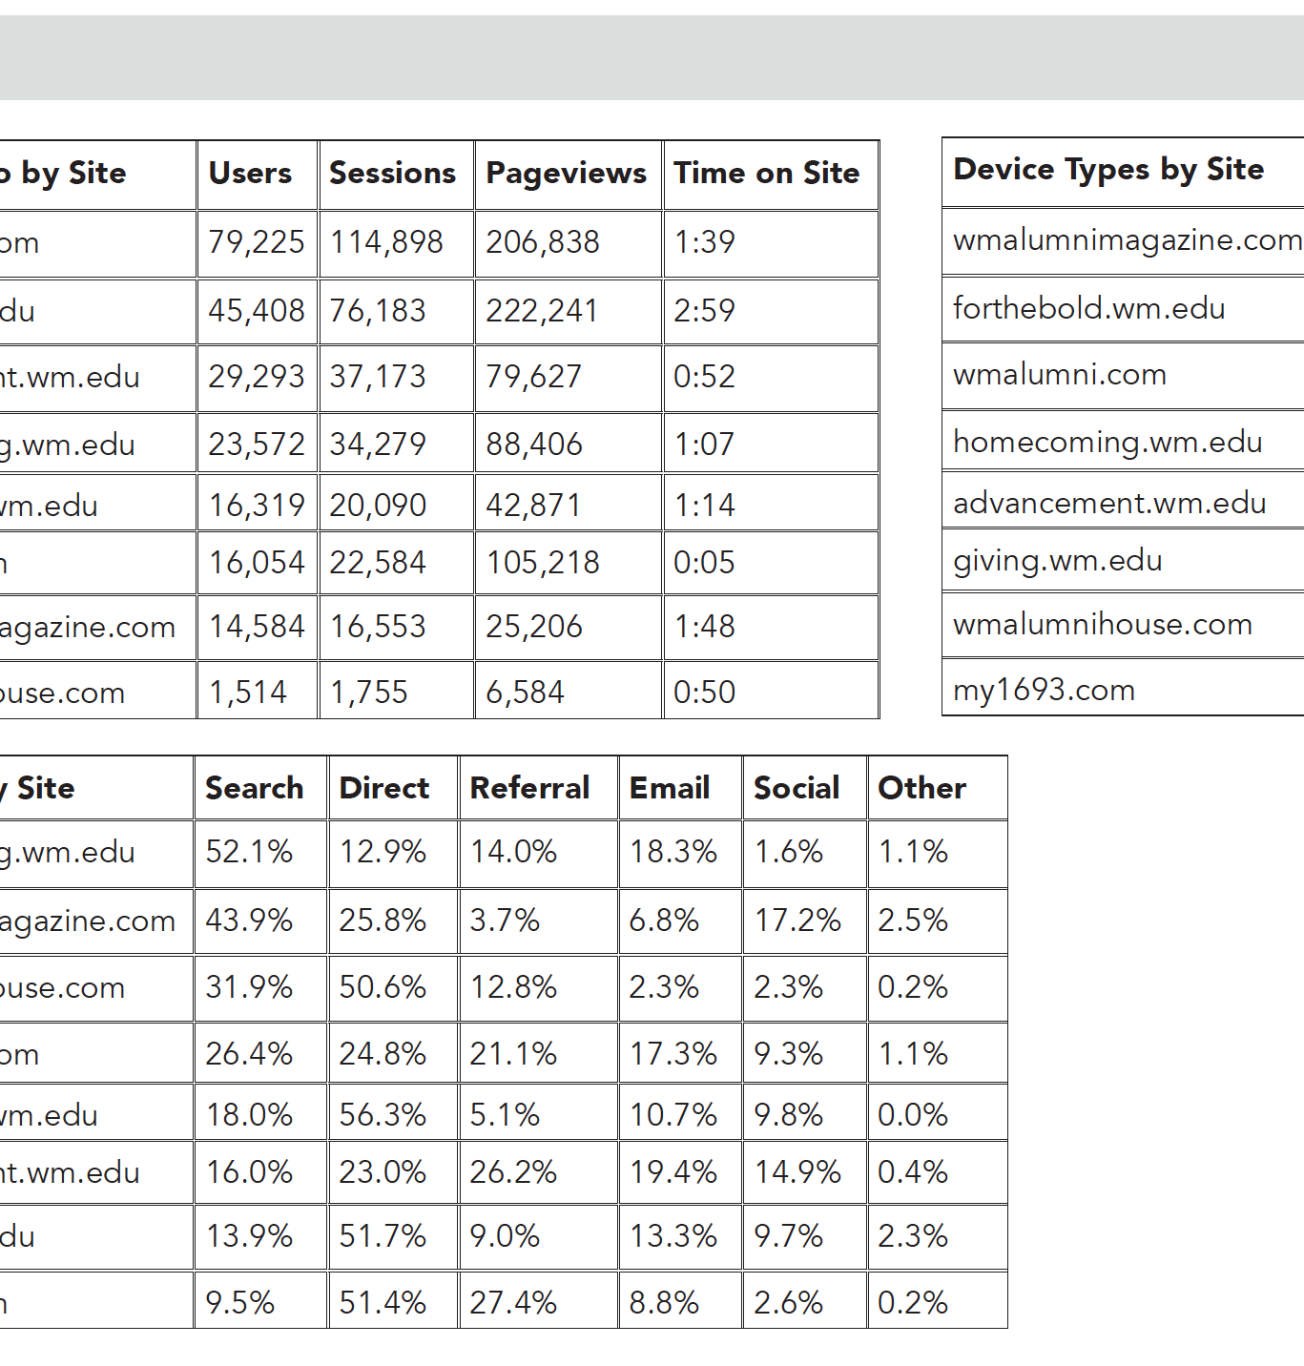
Where We Started
Hand-typed Adobe InDesign document, exported to PDF
Supervisor usually spent a weekend doing it
No automated data entry
No automatic comparisons
No visualization changes without changing the InDesign template
Broken ecommerce setup in Google Analytics
#tea1

Slide 19
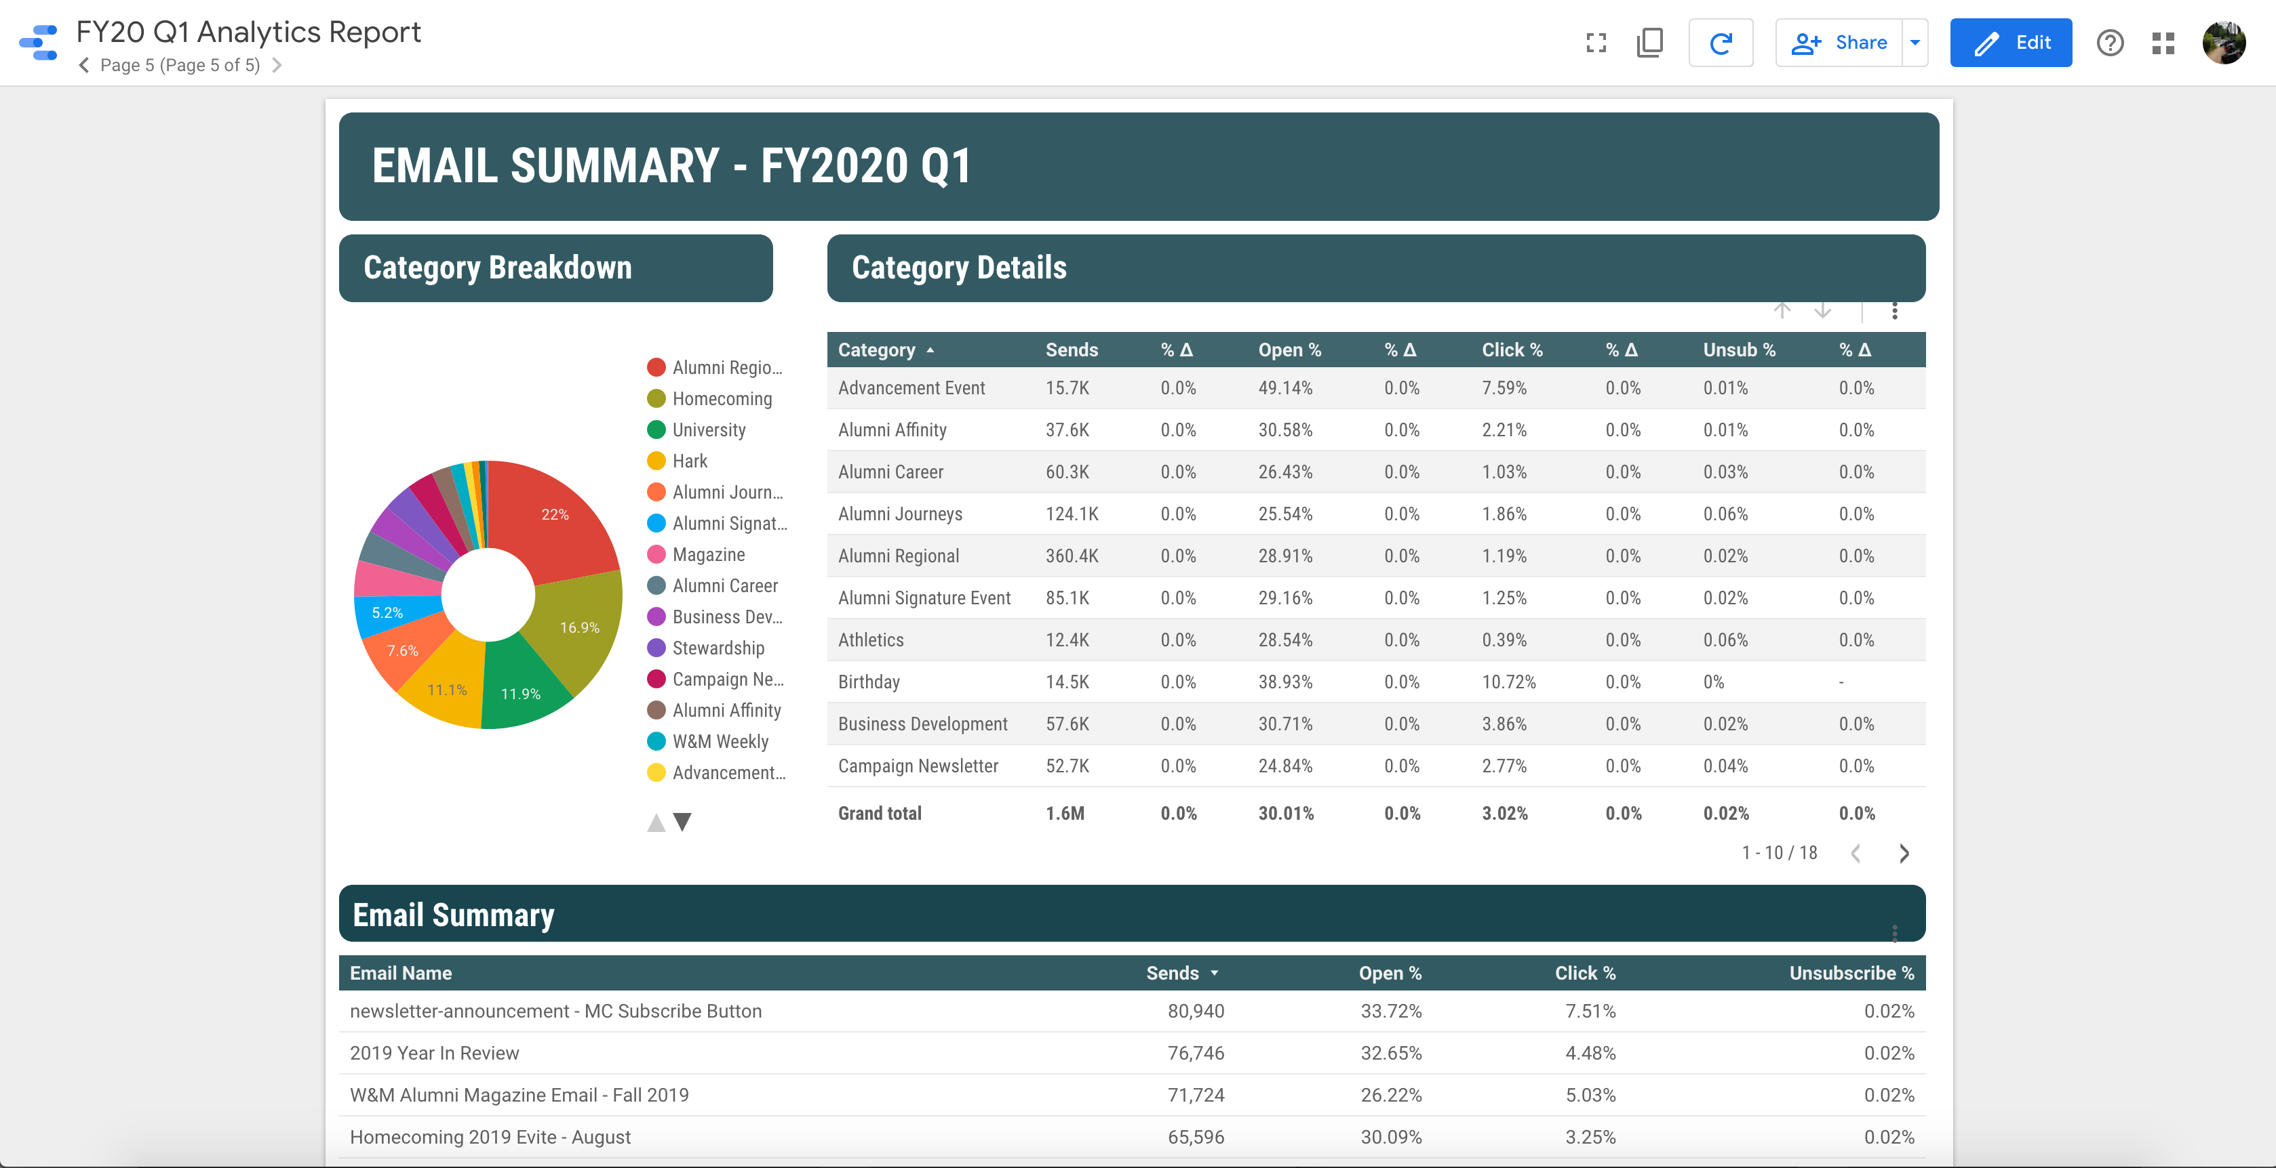
Meet Google Data Studio
Rapid visualization & reporting
Team-based permissions (or release publicly)
Wired directly into Google Analytics — zero effort required for web reporting
#tea1

Slide 20
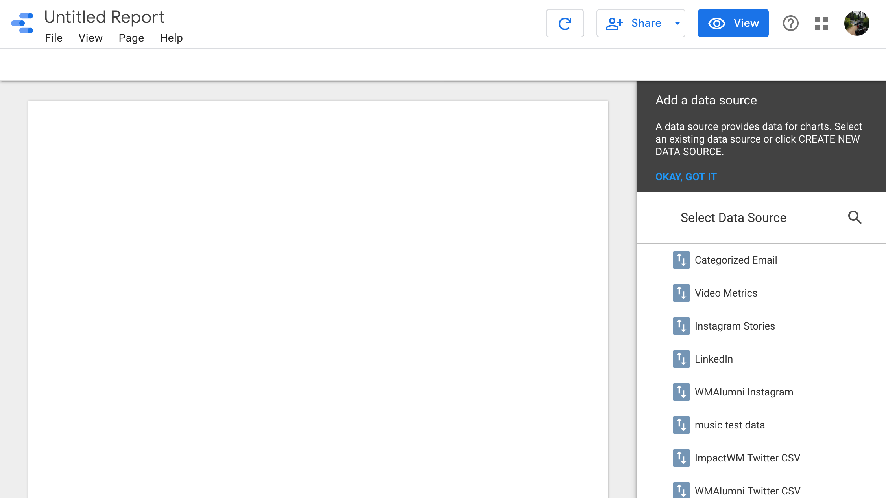

Slide 21
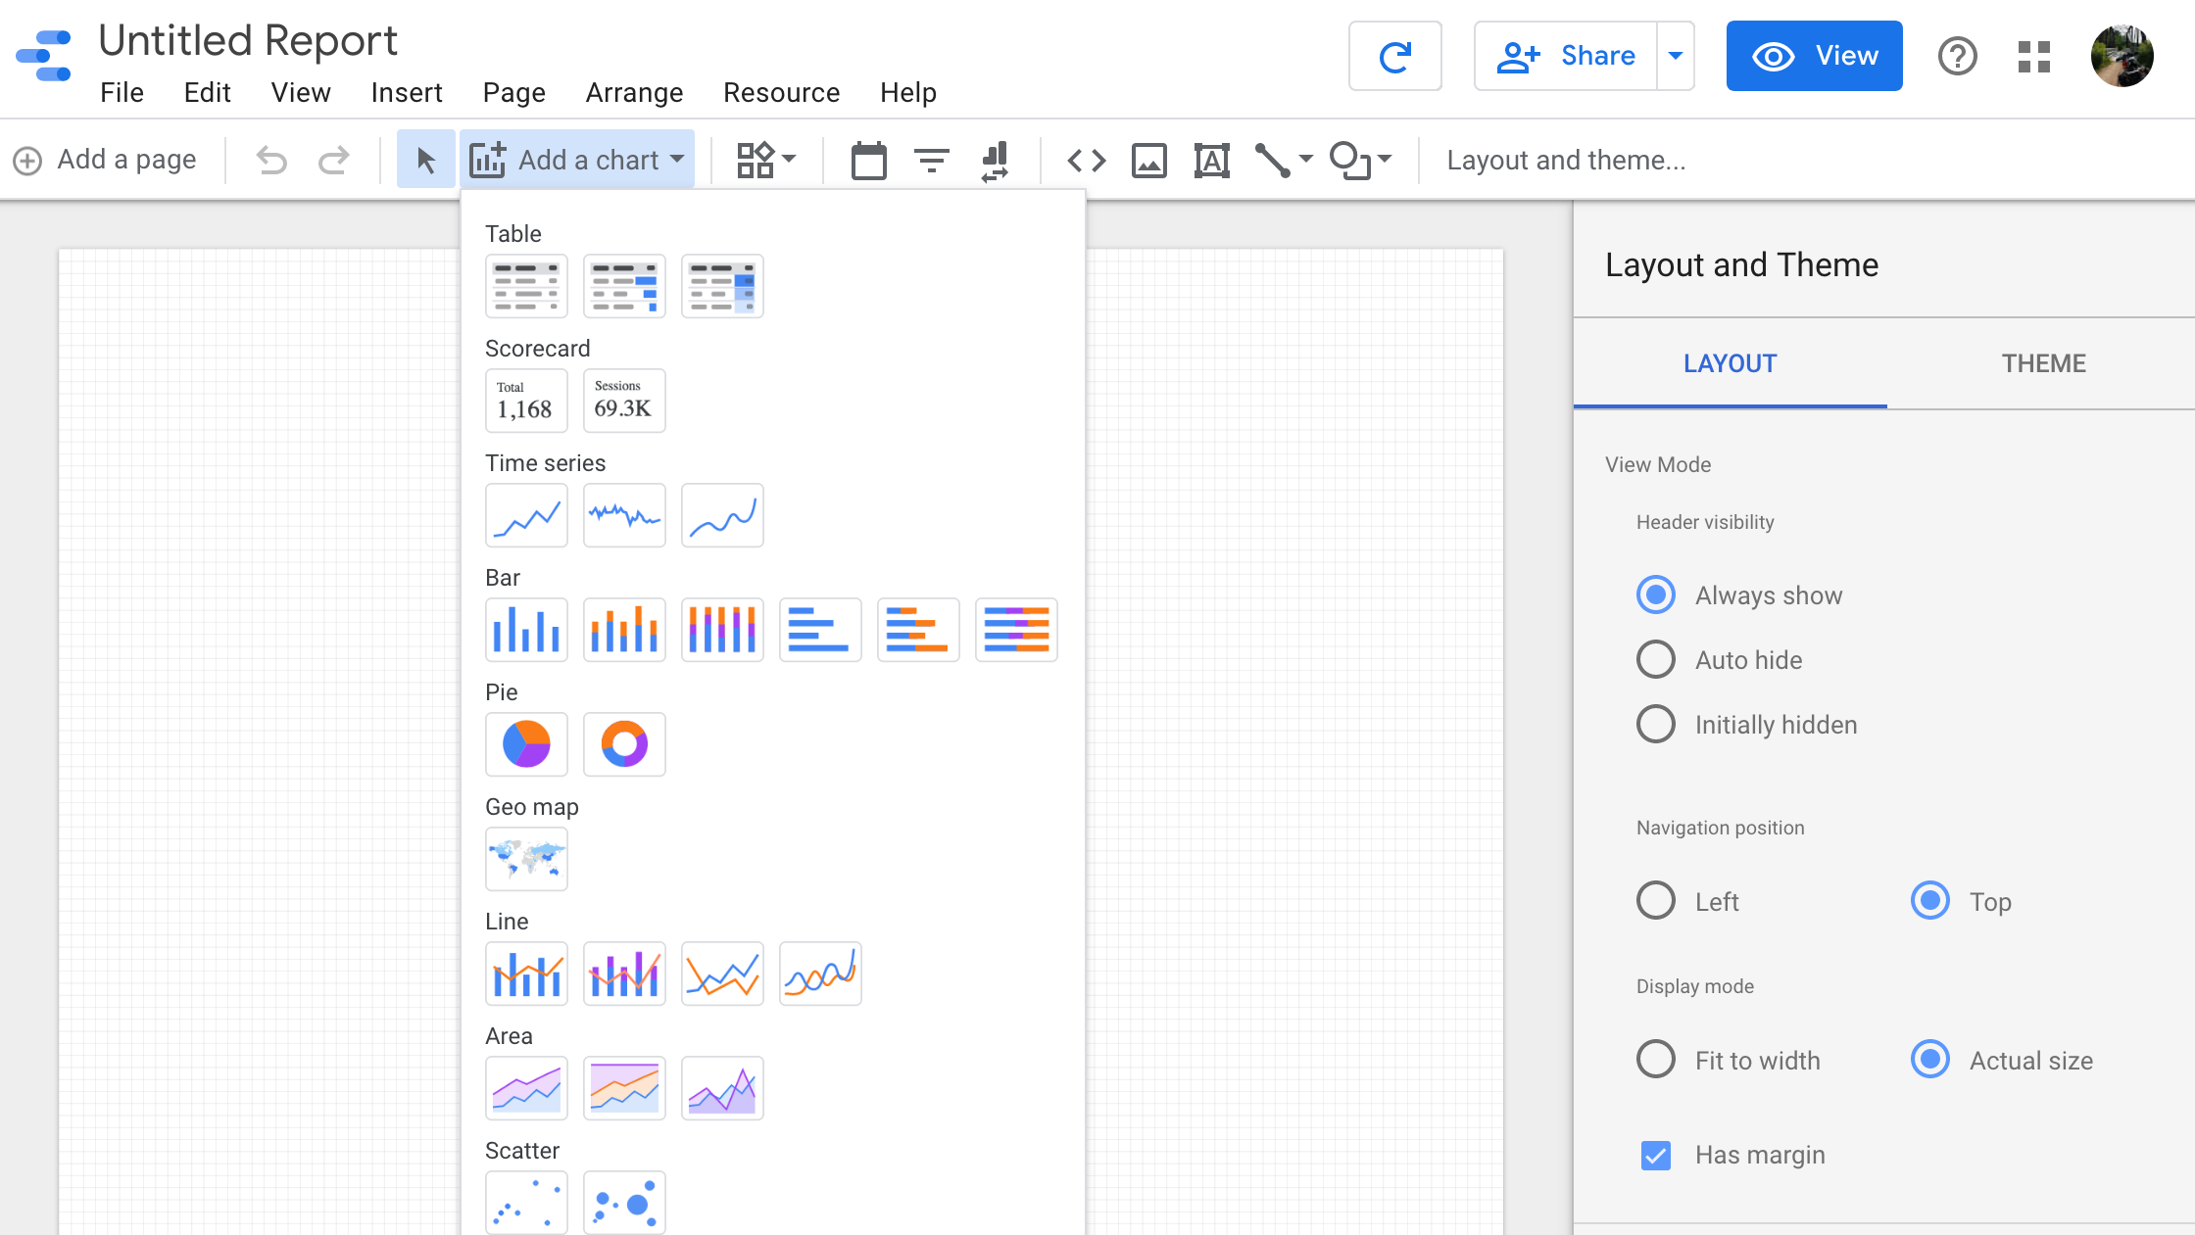

Slide 22
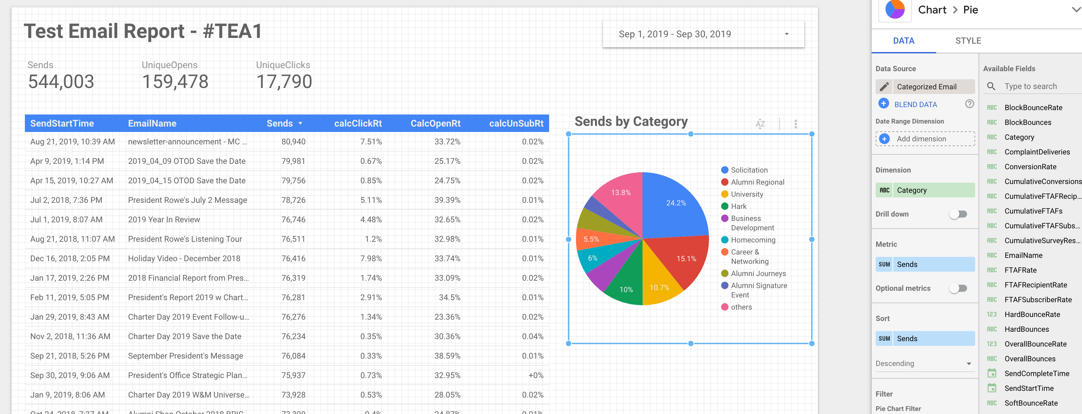
See example in action: tiny.cc/heweb19tea1
Easy rapid visualization
This took less 10 minutes to set up, start to finish (once the data’s in, it’s easy)
Interactive!
Change the date picker
Click the pie chart to see specific categories in the table

Slide 23
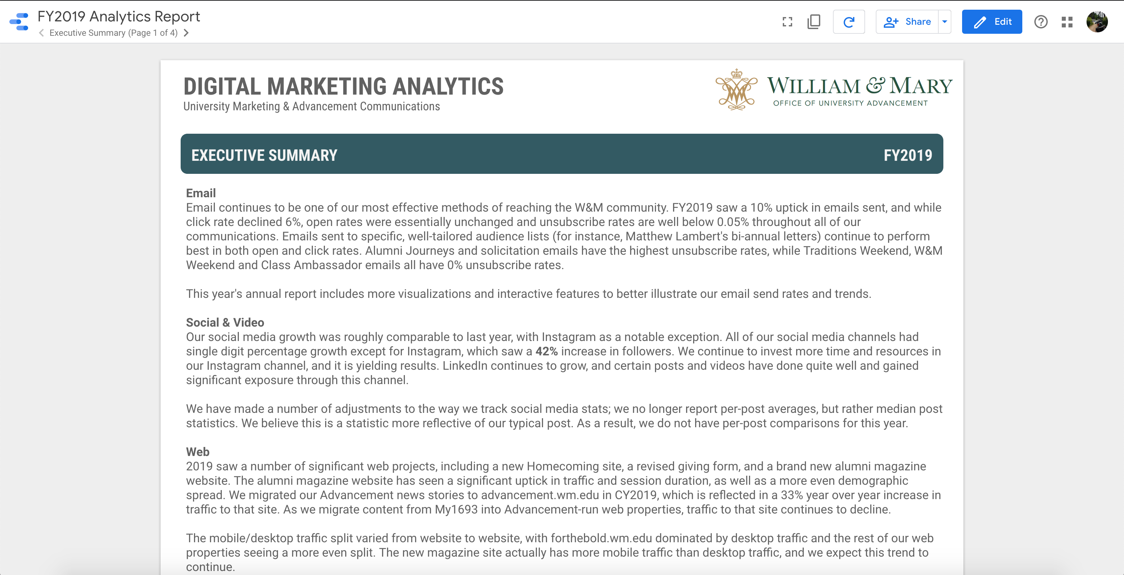
Google Data Studio
See live August report: https://advancement.wm.edu/analytics
#tea1

Slide 24
Google Data Studio
See live August report: https://advancement.wm.edu/analytics
#tea1
Notes:
Email Reporting

Slide 25
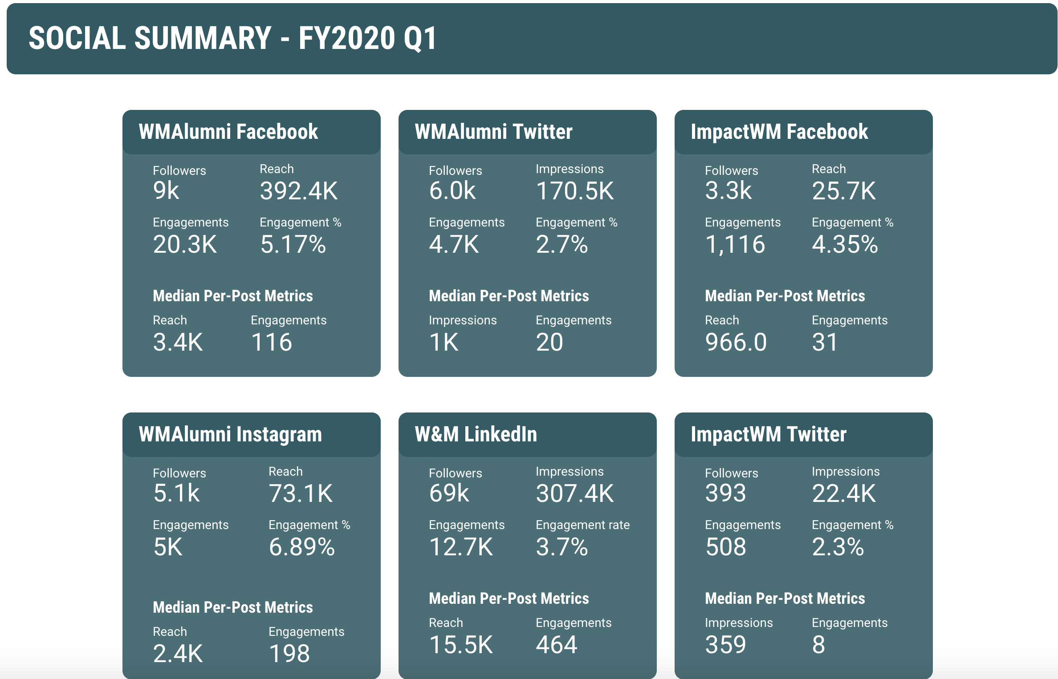
Google Data Studio
See live August report: https://advancement.wm.edu/analytics
#tea1
Notes:
Social Reporting

Slide 26
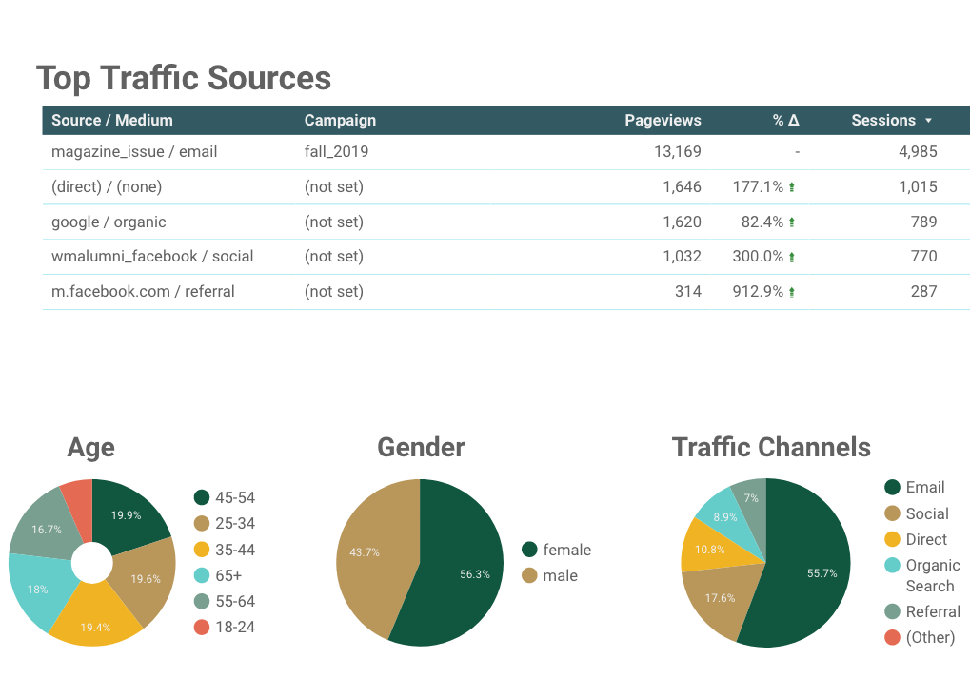
Google Data Studio
See live August report: https://advancement.wm.edu/analytics
#tea1
Notes:
Traffic source reporting
UTM Tags – Jackie’s presentation, “From “UMM…Codes?” To UTM Codes” LIT13, Tuesday, 1:30
Data Driven Comms – Brian Piper in STR7, Tuesday at 9:30

Slide 27
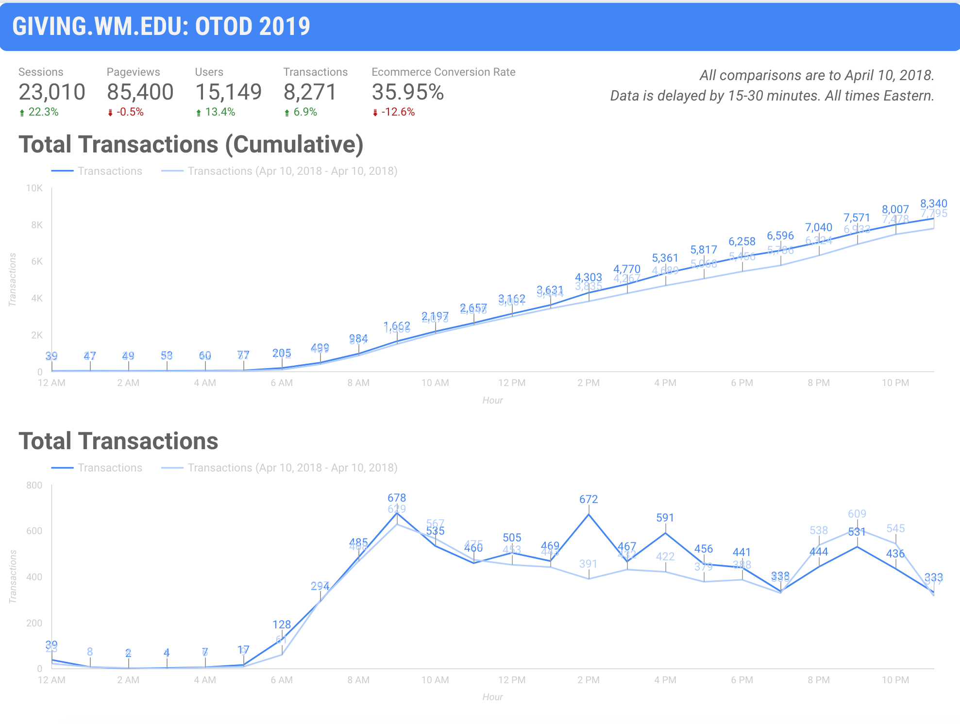
Google Data Studio
#tea1
Notes:
Real-Time Reporting (OTOD)

Slide 28
Part 2 – Building a Data-Infused Culture
#tea1
Notes:
Data infused!
You’re probably gonna be a department of one of this – I certainly was.

Slide 29
Basic Analytics Flow
Visitors
Data
Reporting
Communications
#tea1
Notes:
So this is what we’ve got so far.
We COMMUNICATE with our audiences, who show up at our digital properties, do stuff that results in data, which we report on!

Slide 30
We’re missing something :(
Data
Frustrated audience
Never-Ending Meaningless Reporting Work
Stale Comms Strategy
Frustration & Burnout
#tea1
Notes:
But without closing this loop here’s what it actually is

Slide 31
What’s missing?
institutional support
Stakeholder buy-in
Data-infused strategic planning
#tea1

Slide 32
Data-infused decision-making culture closes the loop
Data
Happier Visitors
Reporting
Iteratively Improved Comms Strategy
Data-Infused Strategic Planning
#tea1
Notes:
But how do we get there?

Slide 33

Building a data-infused culture
Become your org’s analytics SME
Proactively build rapport with colleagues
Aim for small victories early, then build on them
Set SMART goals
#tea1

Slide 34
Become the analytics SME
Immerse yourself in your data
Admit when you don’t know things
Prize credibility above all — if you’re not sure, say so. If you need more time to give a good answer, say so.
#tea1
Notes:
Create and examine your data regularly, not just at at reporting time
Check on crazy ideas that occur to you
Be in your data sources every day

Slide 35
Build rapport with colleagues
“Seek first to understand, then to be understood”
You need to know both your analytics and your colleagues’ priorities and mission
Get people on your side by informally reaching out to friendly colleagues
Sit in on meetings
#tea1
Notes:
7 habits of highly effective people by dr Stephen Covey
You may know your data really well, but without context about its application you won’t be a helpful as you could be.
Ask your coworkers what they’d want to know that they don’t already. Sometimes it’ll be things you can help with, sometimes it won’t — but either way you’ll gain more insight into your colleagues’ priorities and planning processes.

Slide 36
Aim for small victories
In early days especially: limit the scope of your data-driven projects
Clearly define scope and terms of success/failure
A/B testing small web design changes is a good place to start (use Google Optimize)
These small victories lead to higher levels of trust and the opportunity for more impact
#tea1
Notes:
Giving form button that increased mobile conversion rates

Slide 37
Set SMART goals
Specific
“We think this design change will improve conversion rates…”
Measurable
“…by X%”
Achievable
“It’ll take 2 developer hours…”
Relevant
“This supports our strategic goals because…”
Time-bound
“We’ll A/B test over June and re-evaluate.”
#tea1

Slide 38
Example: Email Sends
Email is our primary communication & solicitation tool
W&M Advancement sent 7.4 million emails (2.2 million solicitation emails) in FY19
When we want to talk to our alumni, we write another email
But that adds up…
#tea1
Notes:
I want to talk about an example that sort of encompasses a lot of what we’re talking about

Slide 39
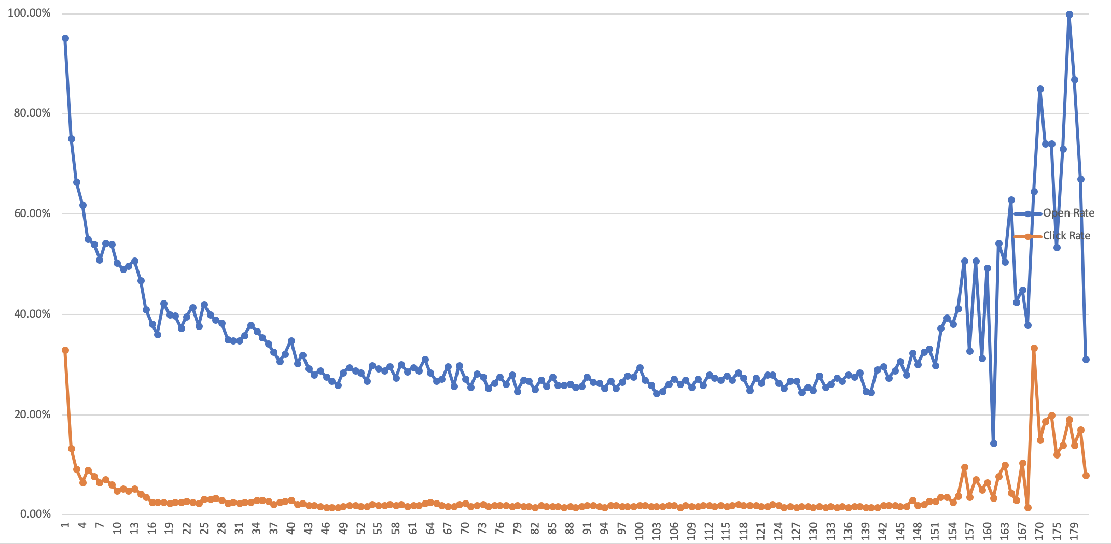




The more times we email someone in a year, the less likely they are to open our emails
People we email this many times respond better!
We email most people this many times

Slide 40
Example: Email Sends
We raised ~$4.7 million through online giving last year, primarily driven by email solicitation
The Power Of Math: $4.7m / 133k clicks = ~$35.09/click
1.81% overall click rate
If we raise our overall click rate 0.5%, we could bring in an additional $1.3m
#tea1
Notes:
Specific! Measurable! Relevant!

Slide 41
Example: Email Sends
The data seems to suggest we should send less email, to raise our open/click rates.
Asked directors to think about this: “If Advancement could only send 40 emails/year, what would they be?”
Everyone had different answers, and while they empathized with the problem, they all had the same question:
“If we can’t send email, what do we do?”
#tea1

Slide 42
Example: Email Sends
We cannot realistically ask Advancement to cut its emails in half.
But we can look for efficiencies:
Combine communications when possible
Consider alternate channels to communicate with our constituents
Aggressively segment emails based not just on affinities, but on previous response to our emails & drop highly responsive and nonresponsive alumni
Example: Homecoming emails
#tea1
Notes:
Specifically spoke with our director of direct marketing
Homecoming emails can get broken into affinities – e.g., young guard, old guard, reunion classes
…but we also need to break them into other groups:
“Have you opened an email from us?”
”Have you ever attended Homecoming?”
“Have you already registered?”
Also, the giving form and such – A/B tested 20% increase in conversion rate

Slide 43
Pitfalls To Avoid
You will discover things that feel like huge problems. Proceed with caution and limit your scope. Search for multiple data points to support your conclusions
Suppress the urge to shout your discoveries from the mountaintops. Their time will come. Be methodical and realistic.
You’ll know your data better in a year than you will in those first few months, and even better two years after that.
#tea1

Slide 44
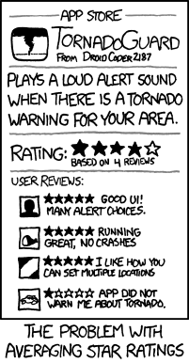
Be careful when aggregating data
Sometimes averages don’t tell the whole story
Consider other measures of central tendency
Medians are sometimes more useful than averages, especially for data that contains significant outliers

Slide 45
Q&A?
“Please don’t shoot the piano player; he is doing his best.”
github: github.com/sflynn850/heweb19
email: sean.flynn@gmail.com
twitter: @wxgeek
linkedin: find nearby / flynns32547
#tea1

